Slide 1
Unit 5
Environmental impact assessment
And
Environmental pollution
Prepared by Mr. Sharma

Slide 2
Chapter 10 - Environmental impact assessment
EIA is a formal process to predict the environmental consequences of human dependent activities and to plan appropriate measures to eliminate or reduce adverse effects and to augment positive effects.
Its a formal process for identifying:
  likely effects of activities or projects on the ENVIRONMENT, and on human health and welfare.
  means and measures to mitigate & monitor these impacts

Slide 3
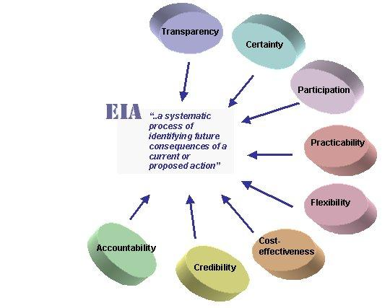
Environmental impact assessment
Functions of EIA:
To predict problems
To find ways to avoid them
To enhance +ve effects

Slide 4
Objectives of EIA
To describe the methodology and output of EIA
To provide inter-disciplinary advice related to any new project to those engaged in preparing EIAs
To enhance institutional capacity for carrying out an EIA

Slide 5
Advantages of EIA
Provide systematic methods of impact assessment
Estimate the cost/benefit trade-off of alternative actions
Facilitate the public participation
Provide as effective mechanism for
  Coordination
  Environmental integration
  Negotiation
  feedback
Top-level decision making
Achieve an balance b/w impact of development and environmental concern

Slide 6
Disadvantages of EIA
Time consuming
Costly
Public participation is very less
unavailability of reliable data
Too focus on scientific analysis (sometimes)
Poor presentation of EIA
Compliance monitoring after EIA is seldom

Slide 7
Elements for preparing EIA statement
Screening
  Results in categorization of project
  Deciding whether EIA is required
  Initial environment examination or evaluation (IEE)
Scooping
  Process of determining most critical issues to study
  Techniques used – baseline studies, checklists, matrices, and network diagrams
Prediction and mitigation
  Feasibility study
  Mitigation is the action taken to avoid or lessen the adverse effects of an activity
Management and monitoring
  To compare predicted and actual impacts
Audit
  Feedback and learning functions
Notes:
Mitigation: To act in such a way as to cause an offense to seem less serious

Slide 8
Chapter 11- Environmental pollution and its control
  Introduction
  Current issues in environmental pollution and its control
  Global warming – causes and effects

Slide 9
Environmental pollution – introduction
Almost every year we feel:
  This summer is hotter than it was last year
  Schedule of monsoon is changing
  Floods and storms are increasing
Climate changes, deforestation, destruction of habitat and increasing pollution leads to
  Acid rain
  Global worming
  Ozone depletion
  Smog etc.

Slide 10
Current issues in environmental pollution and its control
Weighing(considering) benefits and risks
Effects of population growth
Loss of natural resources
Wastefulness in industrial world
Loss of biodiversity
Improper waste management
Nuclear problems
Energy crises

Slide 11
Global warming
Global warming is called greenhouse effect because the gases that are gathering above the earth make the planet comparable to a greenhouse
By trapping the heat near the surface of the earth, greenhouse effect is warming the planet and threatening the environment

Slide 12
Causes of global warming
Overpopulation
Over consumption
Deforestation
Usage of refrigerator
Industrialization
Transportation - CO2, CFCs, nitrogen oxides, methane

Slide 13
Effects of global warming
Climate changing
Temperature increasing
Rise in sea level
Islands are disappear
Habitat loss

Slide 14
Any question

